Slide 1
Rare cause of bilateral visual loss
Presenter : Dr Sahil gupta

Slide 2
Case of 48 year old male presented complaints of dimunition of vision in his left eye since 1 year, insidious in onset ,initially involving his nasal aspect of the visual field of the left eye and gradually progressed to involve all quadrants of left eye visual field .
After 6 months of onset of symptoms , he developed dimunition of vision in his right eye, insidious in onset , which involved his nasal aspect of the visual field of the right eye , static with sparing of the outer aspect of the visual field of right eye.

Slide 3
There was no history of :
Painful eye movements ,headache, orbital pain, double vision.
Ocular trauma.
Motor weakness or sensory complaints.
His bladder and bowel function was normal.
The above complaints were not associated with any preceding viral illness and autoimmune etiology .
There was no history of any weight loss, any drug intake, alcohol , toxin or radiation exposure.
Patient is known hypertensive since 4 years , non diabetic, and he had no other symptoms apart from diminished vision.

Slide 4
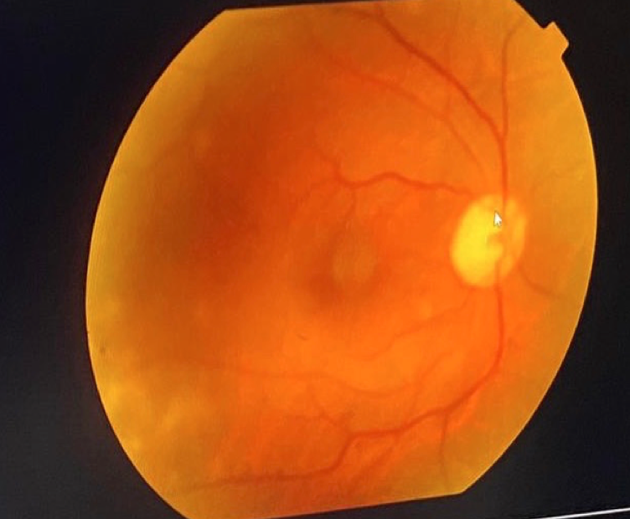
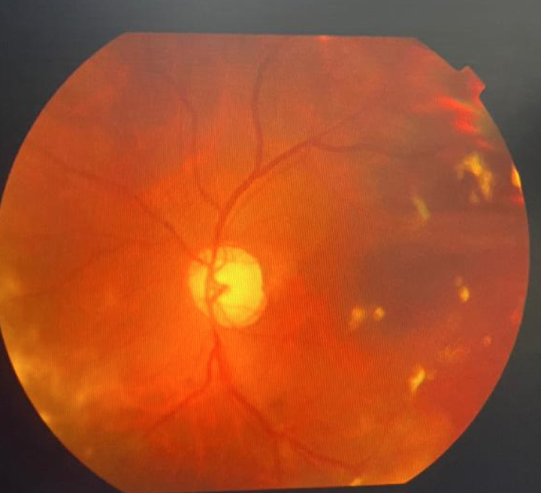
On ocular examination :
On confrontation test , there was nasal visual field defect in right eye and loss of vision in all fields in left eye.
Only perception to light was seen in left eye.
RAPD was present in Right eye.
Eye movements were normal and other cranial nerve examination was normal.
Fundus exam showed pale disc in both eyes with clear optic disc margins.
The intraocular pressure was 21 mmHg bilaterally, and there was no glaucomatous cupping and the retinas appeared normal.
Right eye
Left eye

Slide 5
Motor system and Sensory examination normal
No neurocutaneous markers seen.
No skeletal deformities seen
No spinal deformities
Examinations of cardiovascular, respiratory and gastrointestinal system were unremarkable.
No hypopigmention/hyperpigmentation of skin seen.

Slide 6
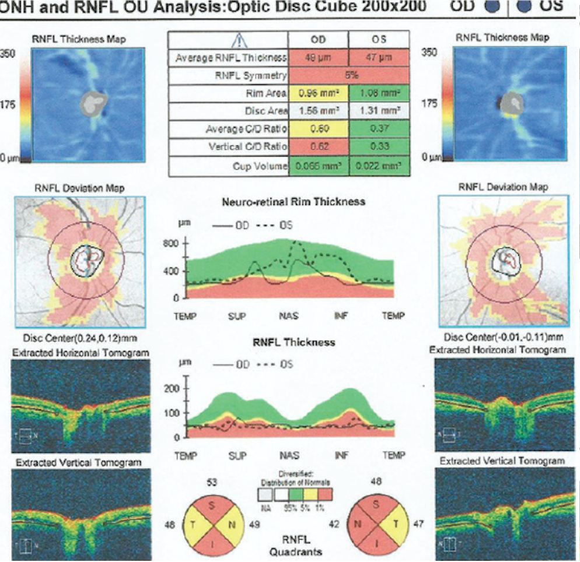
Patient got his perimetry done 6 months back in which right eye was normal and there was nasal hemianopia in left eye . In the repeat perimetry done after 1 year , there was nasal hemianopia in his right eye and complete loss of visual field in his left eye. Spectral domain Optical Coherence Tomography shows retinal nerve fibre layer thinning in both eyes suggestive of optic atrophy which was more in the left compared to the right eye.
Left eye
Right eye

Slide 7
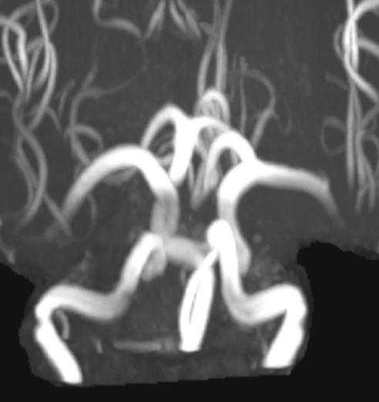
VEP study was suggestive of absent potential in left eye and prolonged latency and decreased P100 amplitude in right eye. All Laboratory parameters were within normal range. Vasculitic workup including ANA –IFA , ANA BLOT, ANCA profile ,as well as NMO panel and MS panel were negative . MRI brain with orbital and optic nerve cuts with MR angiogram with contrast was done . Entire Cardiac work up and CT abdomen was done which was normal.
Left ICA indenting cisternal segment of left optic nerve with optic chiasm and Right ICA abutting cisternal segment of right optic nerve with optic chiasm .
Tortuosity and prominence of bilateral ICA , circle of willis and Vertebrobasilar arteries seen on angiogram.

Slide 8
Diagnosis
On the basis of the above clinical presentation and radiological findings , diagnosis of bilateral optic neuropathy occurring due to compression of both the optic nerves secondary to dolichoectasia of bilateral internal carotid artery was made.
As the patient had preserved vision in his right eye , he was advised for neurosurgical intervention but the patient refused for any surgical intervention.

Slide 9
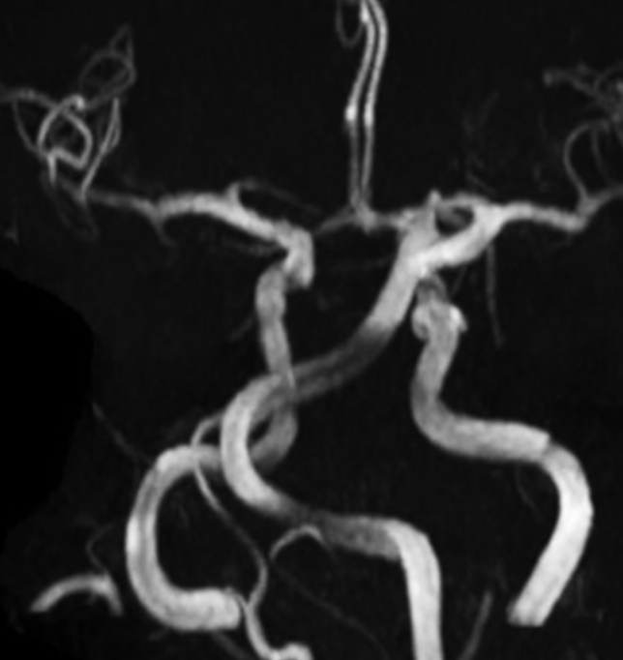
Discussion
Intracranial arterial dolichoectasia is an unusual arteriopathy characterized by abnormal elongation, tortuosity, and dilation of the cerebral arteries .
Dolichoectasia comes from the Greek dolikhós that means long, and ektasis that literally means distention of a tubular structure.
Different terms such as mega-artery, mega dolichoartery, fusiform aneurysm, serpentiform aneurysm, and dilatative arteriopathy have been used to describe the abnormal distention and elongation of intracranial arteries.

Slide 10
Pathology
Tunica media of the arterial wall in patients with IADE is affected by disruption of the internal elastic lamina, atrophy of the muscle layer, and hyalinization of connective tissue, leading to abnormal dilation of the affected blood vessel .
Both, the anterior and posterior cerebral circulation could be affected.
However, the basilar artery (BA) is by far the most common affected vessel.
Intracranial arterial dolichoectasia describes the presence of at least one ectatic and/or enlarged artery in the cerebral vasculature.
Notes:
As arrangement of connective tissue is disturbed --> vessel wall is unable to hold its original conformation and begins to unravel .

Slide 11
Risk factors
Arterial dolichoectasia seems to be related to hemodynamic and anatomical factors in the setting of individual-to-individual susceptibility for developing this arteriopathy.
Aging, male gender, and arterial hypertension ,Cigarette smoking, increased body-mass index, dyslipidemia, and diabetes mellitus are consistently associated with IADE.
A variety of hereditary conditions including Marfan syndrome, Ehlers–Danlos syndrome type IV, neurofibromatosis type 1, tuberous sclerosis complex, Fabry disease, Pompe disease have been associated with increased risk of IADE.

Slide 12
Clinical Course and Prognosis
Intracranial arterial dolichoectasia can be asymptomatic or may become complicated by one of the following mechanisms:
(1) Abnormal antegrade laminar blood flow predisposing to thrombi formation with or without embolic phenomena.
(2) Occlusion of small penetrating vessels.
3) Compression of surrounding structures including brainstem and cranial nerves.
(4) CSF flow obstruction with resultant hydrocephalus either by direct compression of the third ventricle .
(5) Vessel wall rupture with catastrophic brain hemorrhages

Slide 13
A systematic review with IADE determined the 5-year risk rate for brain infarction (17.6%), brainstem compression (10.3%), transient ischemic attack (10.1%), hemorrhagic stroke (4.7%), hydrocephalus (3.3%), and subarachnoid hemorrhage (2.6%) .
Among individuals with newly diagnosed IADE, it is recommended to screen for other potentially fatal arterial disorders including intracranial saccular aneurysms, abdominal aortic aneurysms, and coronary artery disease .
In young subjects and in those without vascular risk factors, primary predisposing conditions should be considered (i.e., Marfan’s, Fabry’s, adult-onset Pompe’s disease).

Slide 14
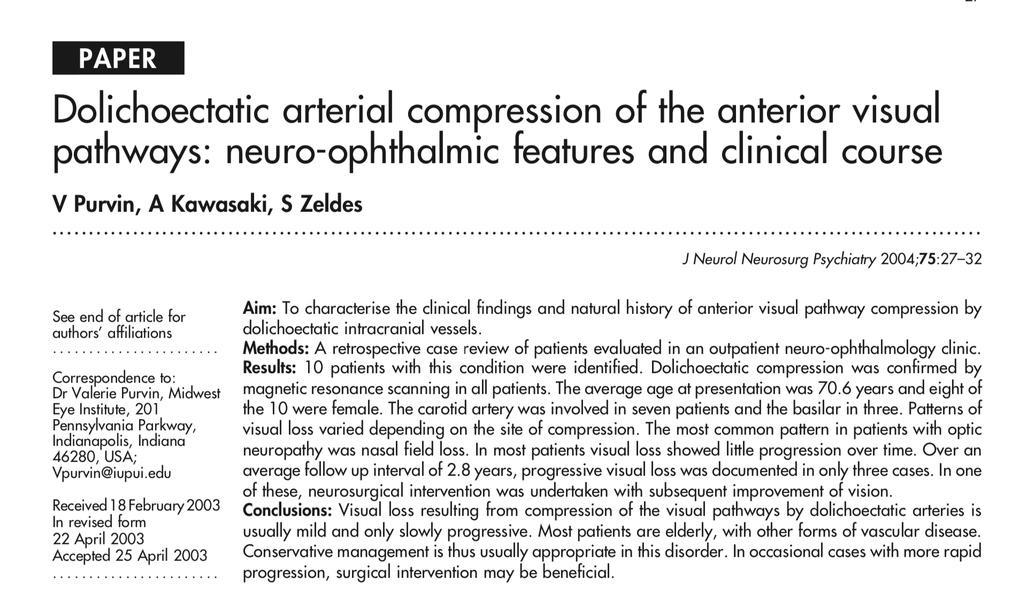
IADE involving anterior circulation is less commonly seen as compared to posterior circulation .

Slide 15
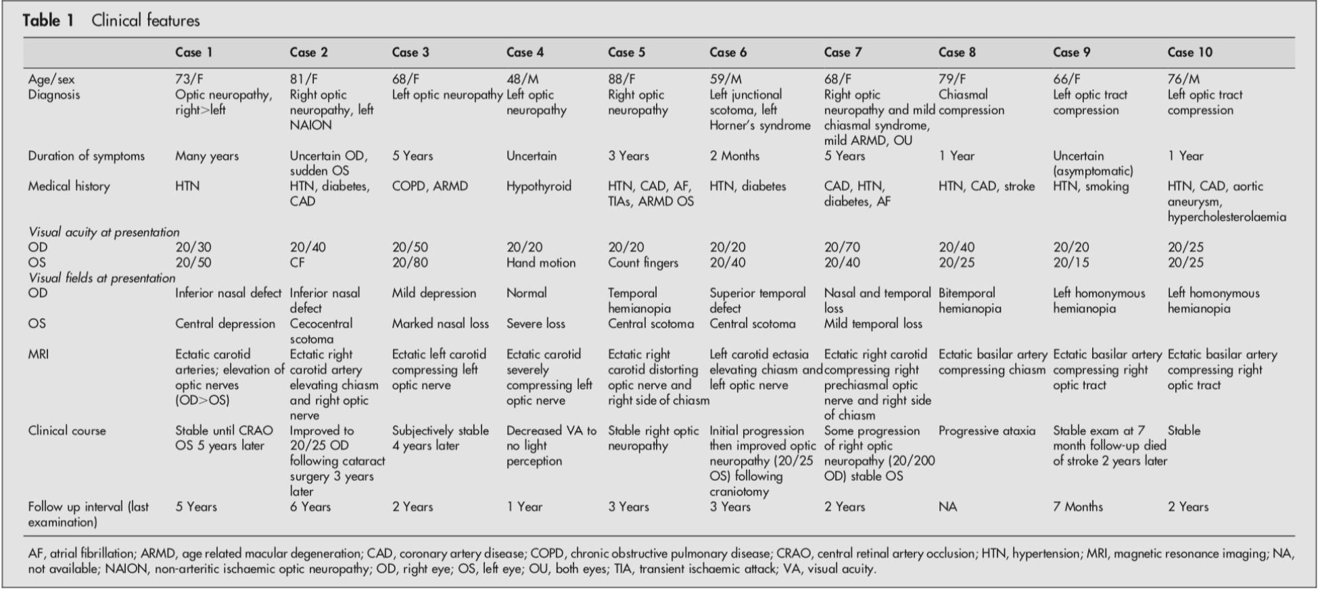

Slide 16
In this case series, 10 patients with this condition were identified.
The carotid artery was involved in seven patients and the basilar in three.
Four patients presented with a unilateral optic neuropathy, one with bilateral optic neuropathy, three had a chiasmal syndrome, and two an optic tract syndrome.
Patterns of visual loss varied depending on the site of compression. The most common pattern in patients with optic neuropathy was nasal field loss.

Slide 17
In all 10 patients initial management was observational. One patient experienced progressive visual loss that prompted surgical intervention which resulted in subsequent improvement of vision .
In the remainder, follow up at regular intervals were done.
For most patients with this disorder conservative management is appropriate as progression is extremely slow and the degree of visual loss is not disabling.
In patients with more rapidly progressive visual loss, surgical intervention may be effective in reversing the visual loss and preventing further deterioration.

Slide 18
Conclusion
Intracranial ICA dolichoectasia causing bilateral optic neuropathy is a rare presentation occurring due to simultaneous compression of the adjacent non-crossing fibres of both optic nerves. In the past, dolichoectatic compression was diagnosed by surgical exploration in most cases. MRI Brain with angiography of head and neck vessels becomes the diagnostic modality of choice without the risk of any invasive procedure. This increased ability to diagnose this condition radiographically should be matched with a heightened awareness of the disorder by the clinician. Early detection and timely intervention can yield reversal in vision loss and prevents any further deteoriation.

Slide 19
Thank you

